Slide 1






23 December 2022
The Dispute Policy Will Increase Revenue by $472,006 This Year
Group 45
Bagiohan, Rick
Go, Juan Antonio
Ocat, Emmanuel
Romero, Rheymart
Solon, Marlon
Velasco, Randy
DATA ANALYTICS
DEPT
Notes:
<a href='https://www.freepik.com/photos/business'>Business photo created by rawpixel.com - www.freepik.com</a>
1

Slide 2








Introduction
A marketing agency like Yellevate focuses on providing marketing services to businesses looking to expand their business. A grave issue with client disputes arose, and the company's management contacted its Data Analytics department to consult on its expertise.
Analytics accepted the challenge!
1
Notes:
Photo by Domenico Loia on Unsplash
<a href='https://www.freepik.com/photos/business'>Business photo created by senivpetro - www.freepik.com</a>
5

Slide 3


Statement of the Problem
Yellevate defines a dispute as dissatisfaction with a company's services and refusal to pay. Nearly 20% of all claims raised against Yellevate resulted in a payment opt-out, resulting in a loss of revenue of around 5% in US dollars for the company.
The company lost $0.69M, find out why!
2
Notes:
Photo by Domenico Loia on Unsplash
<a href='https://www.freepik.com/photos/business'>Business photo created by senivpetro - www.freepik.com</a>
5

Slide 4






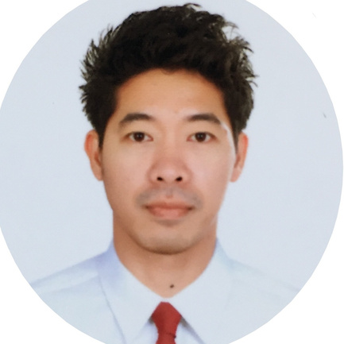


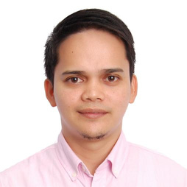
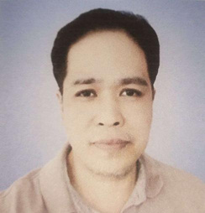
Our Teams
Rick Bagiohan
Data Analyst
Rheymart Romero
Data Analyst
Juan Antonio Go
Data Analyst
Marlon Solon
Data Analyst
Emmanuel Ocat
Data Analyst
Randy Velasco
Data Analyst
3
Notes:
Photo by Domenico Loia on Unsplash
Photo by Nastuh Abootalebi on Unsplash
Photo by Mateus Campos Felipe on Unsplash
Photo by Christina @ wocintechchat.com on Unsplash
Photo by LinkedIn Sales Navigator on Unsplash and Photo by Taylor Grote on Unsplash
12

Slide 5




Objectives
Investigate the root cause of the country suffering the highest revenue loss from disputes
Identify possible patterns relating to customers behaviors
Actively increase the business operations of the top income-generating countries
5
Notes:
Photo by Domenico Loia on Unsplash
<a href='https://www.freepik.com/photos/people'>People photo created by pch.vector - www.freepik.com</a>
6

Slide 6




Goals
An increase in revenue for the company on a long-term basis
Reduce annual disputes costs and losses
4
Notes:
Photo by Domenico Loia on Unsplash
<a href='https://www.freepik.com/photos/people'>People photo created by pch.vector - www.freepik.com</a>
6

Slide 7





Roadmap
Defining the specific activities the occupants of the defined roles should perform
Report to Yellevate's top management
A Plan for Action
Success
Setting Up a Role Definition
Track Deadlines
Specific individuals are responsible for completing tasks. Roles and responsibilities will be held accountable
Timeframe for completion of the plan. Creating a schedule ensures that tasks are completed on time
6
Notes:
Photo by Domenico Loia on Unsplash
<a href='https://www.freepik.com/photos/people'>People photo created by pch.vector - www.freepik.com</a>
6

Slide 8




Methodology
In SQL queries, raw data is cleaned up so that it is easier to understand
Tables and charts were reviewed to develop recommendations
Raw Data
Excel
Presentation
Shared information with company management
SQL
When creating charts, pivot tables are used as a tool
Brainstorming
7
Notes:
Photo by Domenico Loia on Unsplash
7

Slide 9

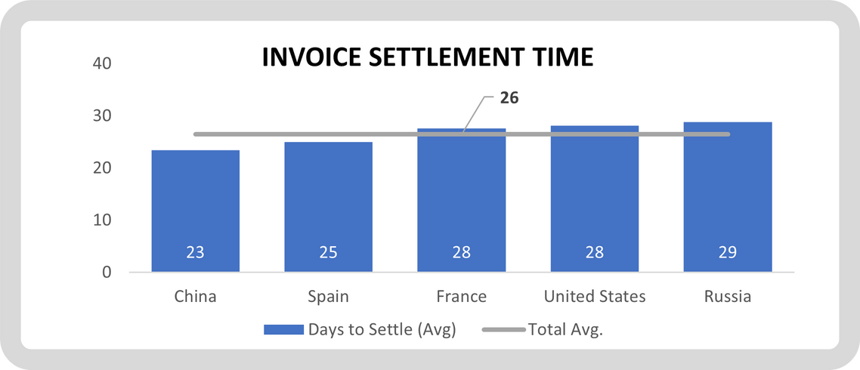
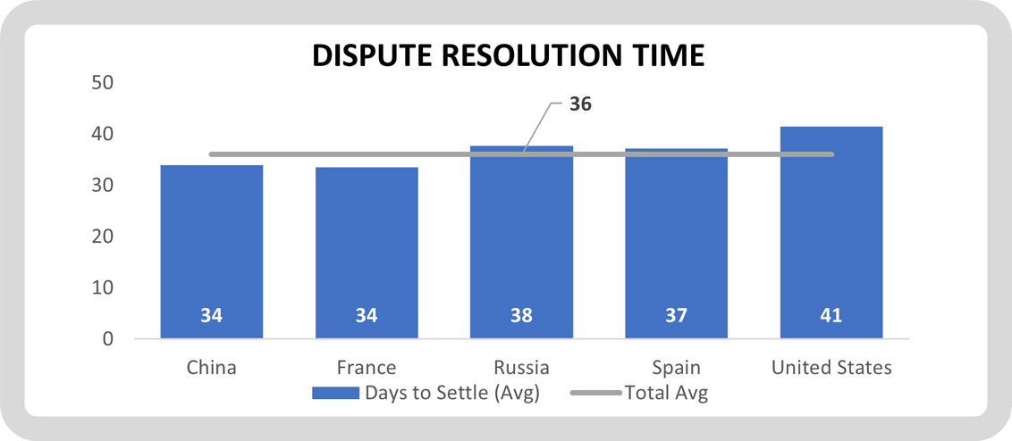
Findings
Invoice Settlement and Dispute Resolution
8
Notes:
Photo by Domenico Loia on Unsplash
<a href='https://www.freepik.com/photos/business'>Business photo created by tirachardz - www.freepik.com</a>
9

Slide 10
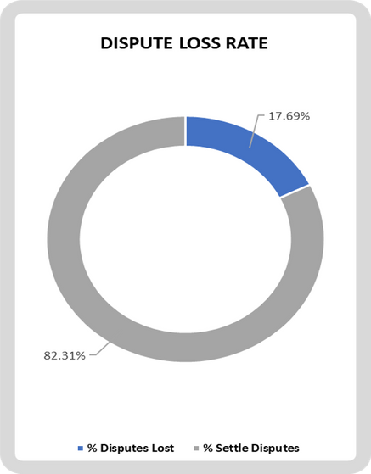
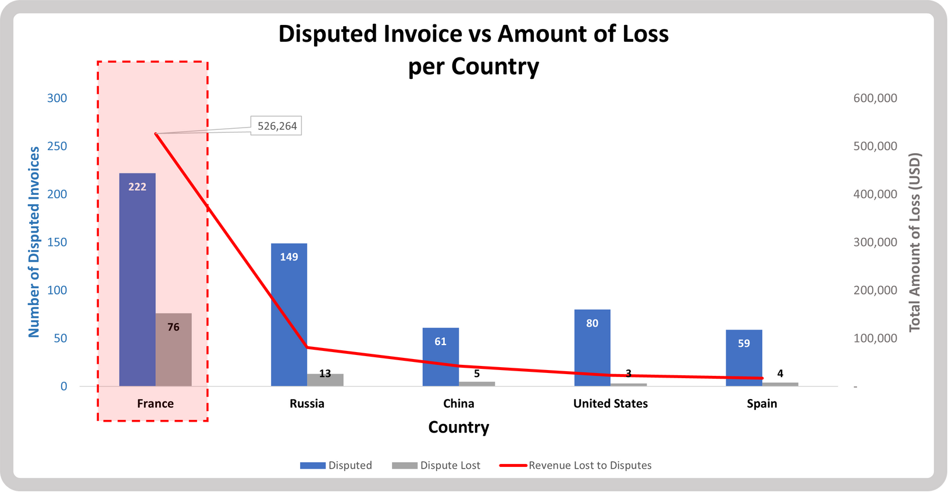
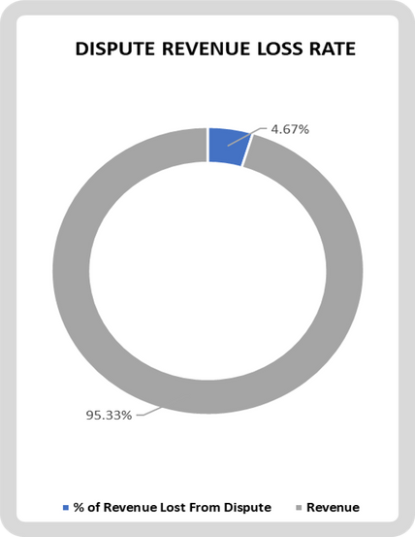
Findings
Disputes and Revenue Loss Rates
9
Notes:
Photo by Domenico Loia on Unsplash
<a href='https://www.freepik.com/photos/business'>Business photo created by tirachardz - www.freepik.com</a>
9

Slide 11
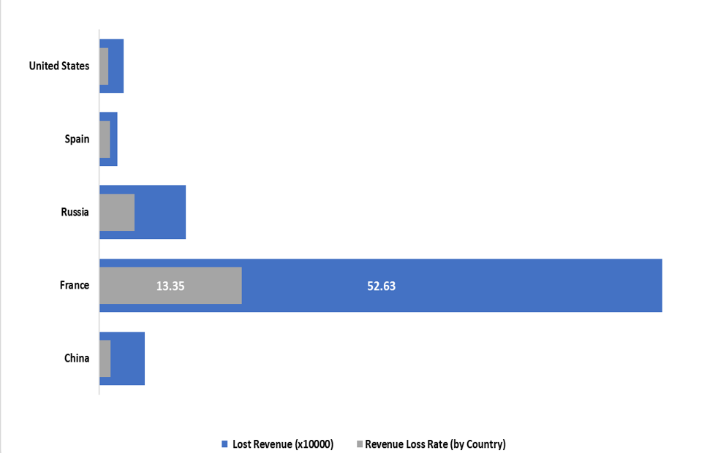
Findings
Country's Highest Lost Dispute Losses (in US Dollars)
10
Notes:
Photo by Domenico Loia on Unsplash
<a href='https://www.freepik.com/photos/business'>Business photo created by tirachardz - www.freepik.com</a>
9

Slide 12

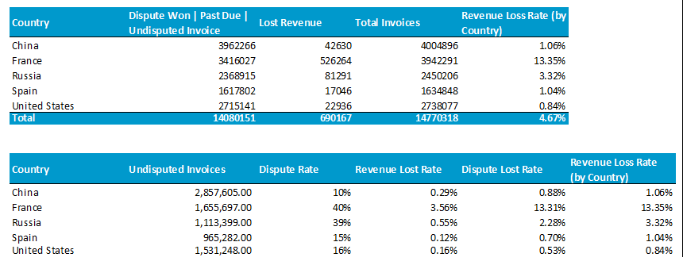
Recommendation
11
Notes:
Photo by Domenico Loia on Unsplash
Photo by Alvaro Reyes on Unsplash
10

Slide 13

Recommendation
Recommendation
Best Factors
Recommendation
Highest number of undisputed invoices worth $2.86 million
Fastest settlements with a 23-day settlement time
Lowest dispute rate with only 10%
Low risk
Expand business operations
Maintain stable business relations
CHINA
12
Notes:
Photo by Domenico Loia on Unsplash
Photo by Alvaro Reyes on Unsplash
10

Slide 14

Recommendation
Recommendation
Best Factors
Recommendation
Positive business outlook for Spain
Second for the lowest dispute rate
Second fastest settlements at 25 days
Low risk
Expand business operations
Maintain stable business relations
SPAIN
13
Notes:
Photo by Domenico Loia on Unsplash
Photo by Alvaro Reyes on Unsplash
10

Slide 15

Recommendation
Recommendation
Best Factors
Recommendation
Third for undisputed invoices
Third lowest dispute rate
Third fastest settlements at 28 days
Low risk, 0.84% loss rate
Expand business operations
Maintain stable business relations
Dispute timeline assessment
USA
14
Notes:
Photo by Domenico Loia on Unsplash
Photo by Alvaro Reyes on Unsplash
10

Slide 16

Recommendation
Recommendation
Unsafe Factors
Recommendation
Second-highest dispute rate at 39%
Opt-outs and contract terms are unclear
Quite risky
Term revisions are necessary for a contract
RUSSIA
15
Notes:
Photo by Domenico Loia on Unsplash
Photo by Alvaro Reyes on Unsplash
10

Slide 17

Recommendation
Recommendation
Best Factors
Recommendation
Top 2 for undisputed invoices
Fastest dispute resolution
Maintain healthy business relations
Standard dispute policy required
Term revisions are necessary for a contract
Unsafe Factors
Highest loss rate at 13.35%, high-risk
Opt-outs and contract terms are unclear
FRANCE
16
Notes:
Photo by Domenico Loia on Unsplash
Photo by Alvaro Reyes on Unsplash
10

Slide 18



Recommendation
Other Recommendations
Review and change the process sequence for a more strategic approach
Hire native-speaking customer service representatives
Reward on-time paying clients
17
Notes:
Photo by Domenico Loia on Unsplash
Photo by Alvaro Reyes on Unsplash
10

Slide 19
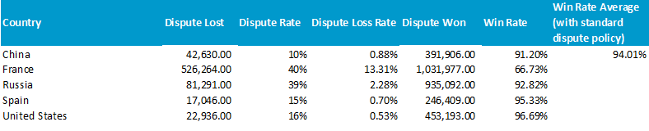
Please refer to the report on pages 8 and 9 for the complete computations.
18
Notes:
Photo by Domenico Loia on Unsplash
<a href='https://www.freepik.com/photos/people'>People photo created by pch.vector - www.freepik.com</a>
6

Slide 20




Thank You

